Slide 1

LAB2:
Multidimensional Data Visualization/ basic techniques
Zespół: Wizualizacja dużych zbiorów danych
Kod: qgq2t7b
Prof dr hab. inż. Witold Dzwinel
Instytut Informatyki AGH

Slide 2
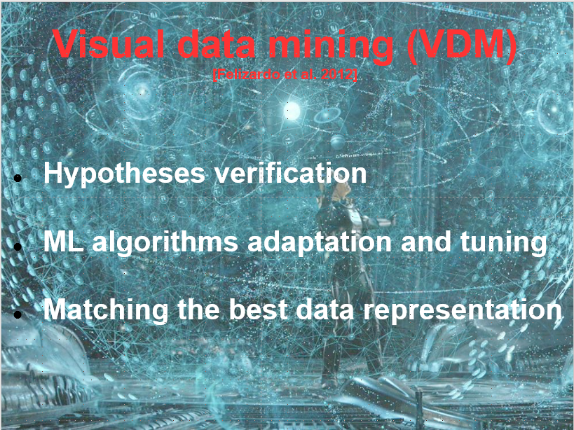

Slide 3
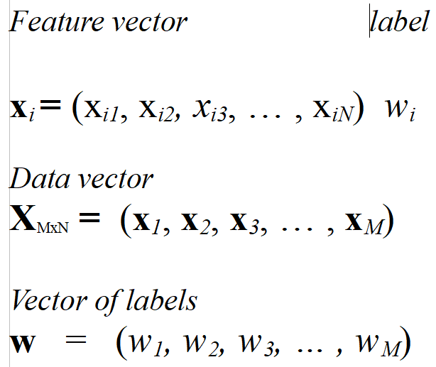
Vectors → data representation

Slide 4
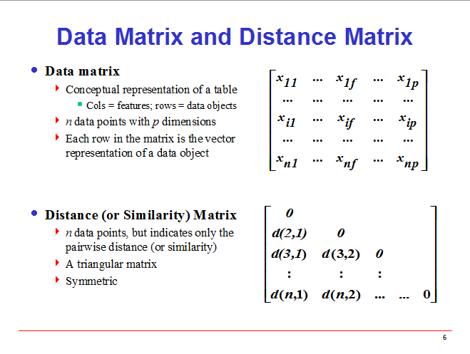
Notes:
4

Slide 5
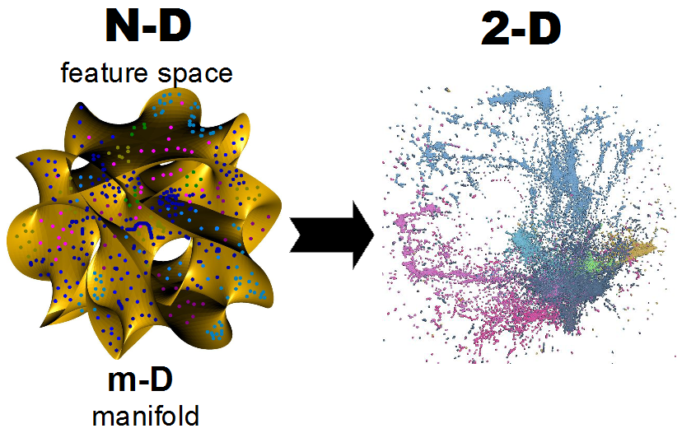
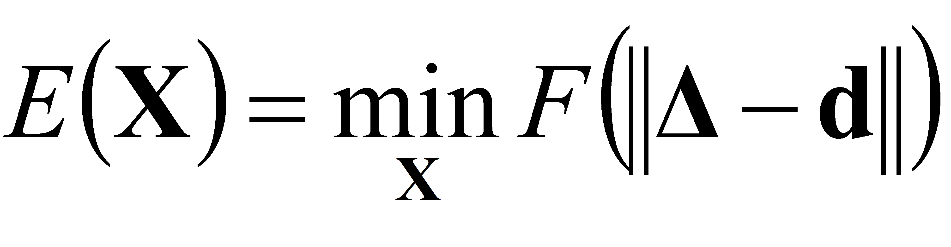
Topic → interactive visualization via embedding of large high dim data

Slide 6
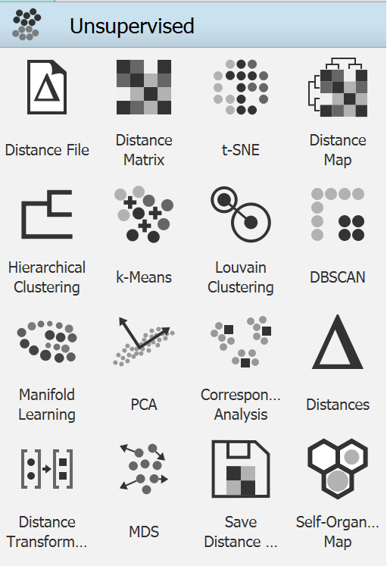
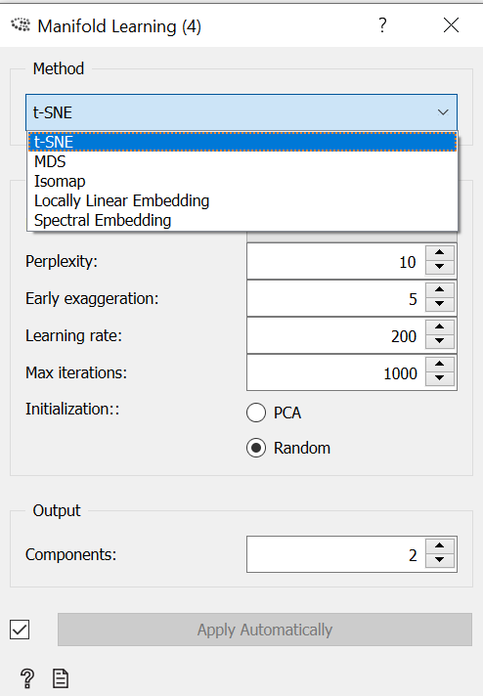
Multidimensional data
visualization

Slide 7
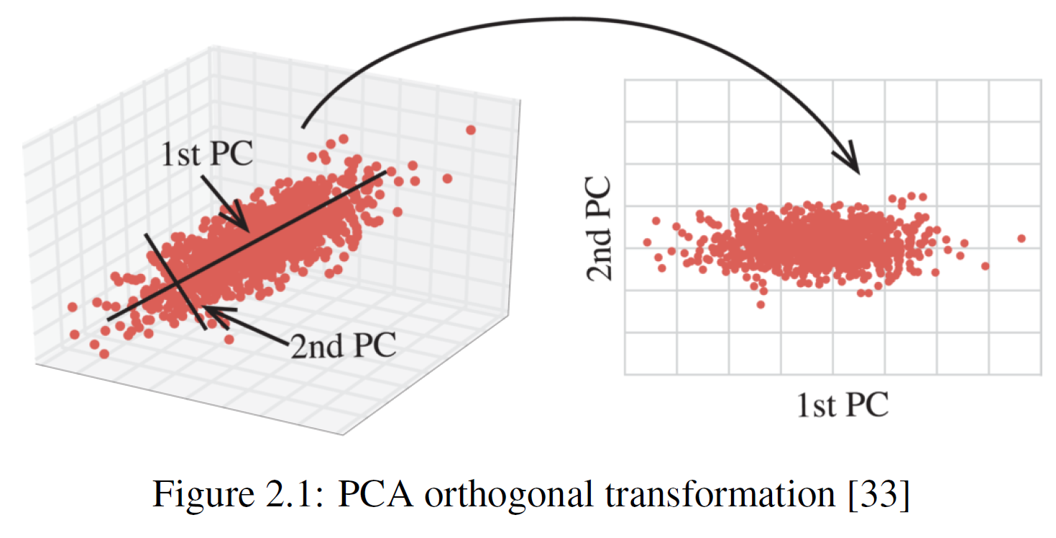
Principal Component Analysis

Slide 8
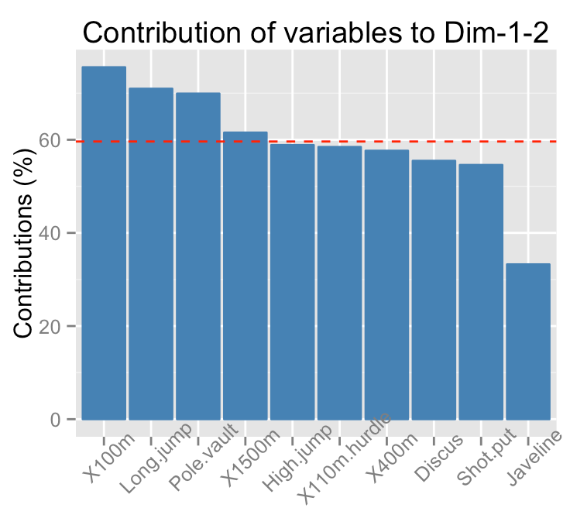
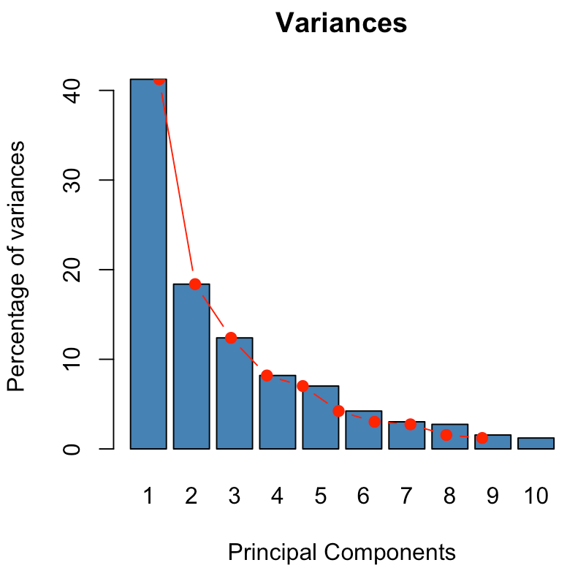
Eigenvalues → contribution

Slide 9
Kruskal MDS and NLM
Kruskal – classic MDS
metric MDS – gradient method
2. non-metric MDS – increasing order sorted list of distances between all points pairs – position on the list → terminal distances
3. Sammon non-linear mapping (NLM)
Notes:
10

Slide 10
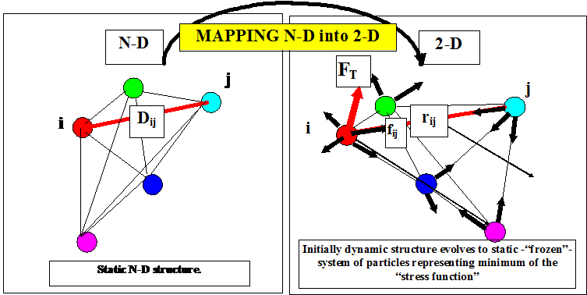
Multidimensional scaling
Dzwinel W, Blasiak J, Future Generation Computers Systems, 15, 365-379, 1999

Slide 11
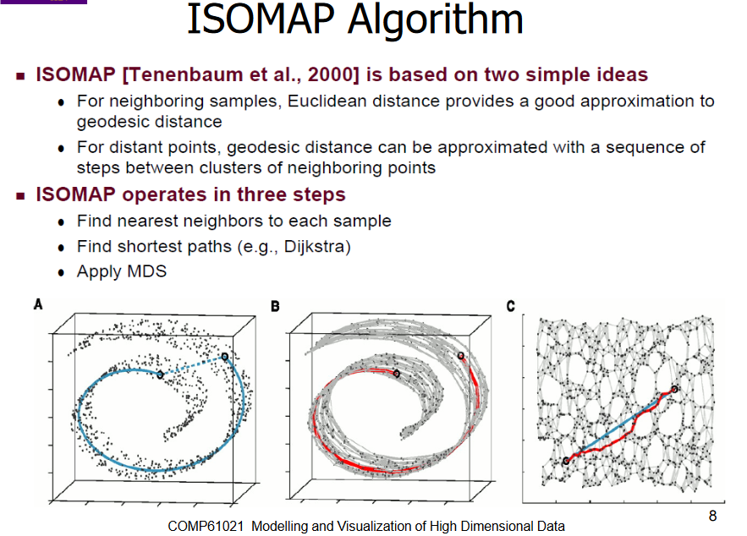

Slide 12
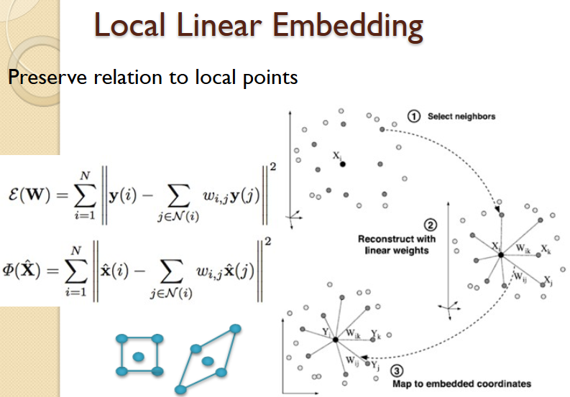

Slide 13
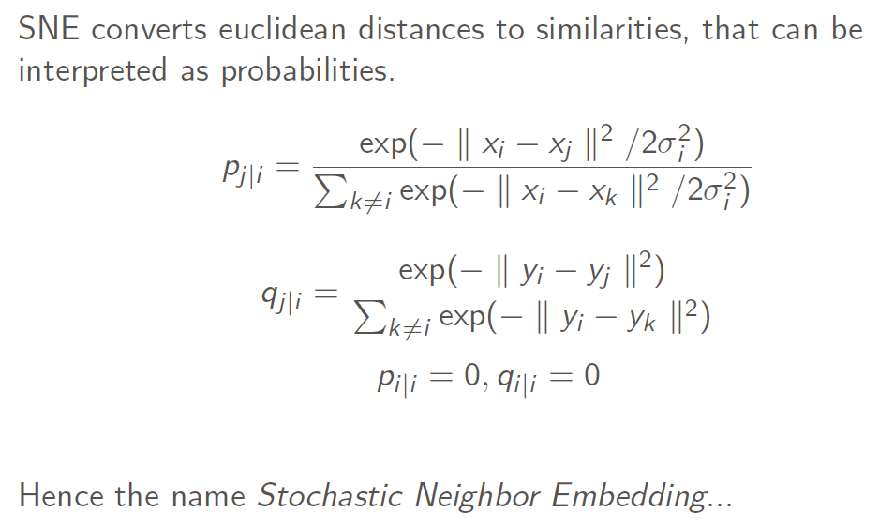
SNE Stochastic Neighbor Embedding

Slide 14
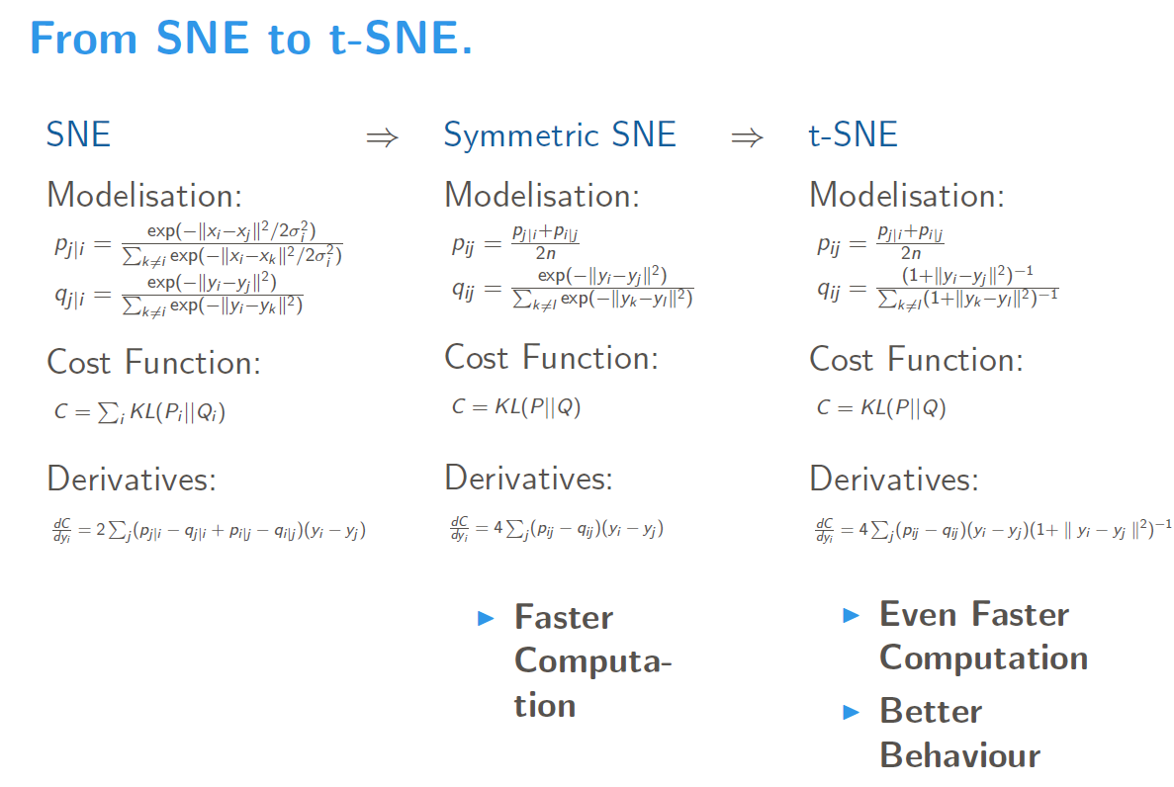

Slide 15
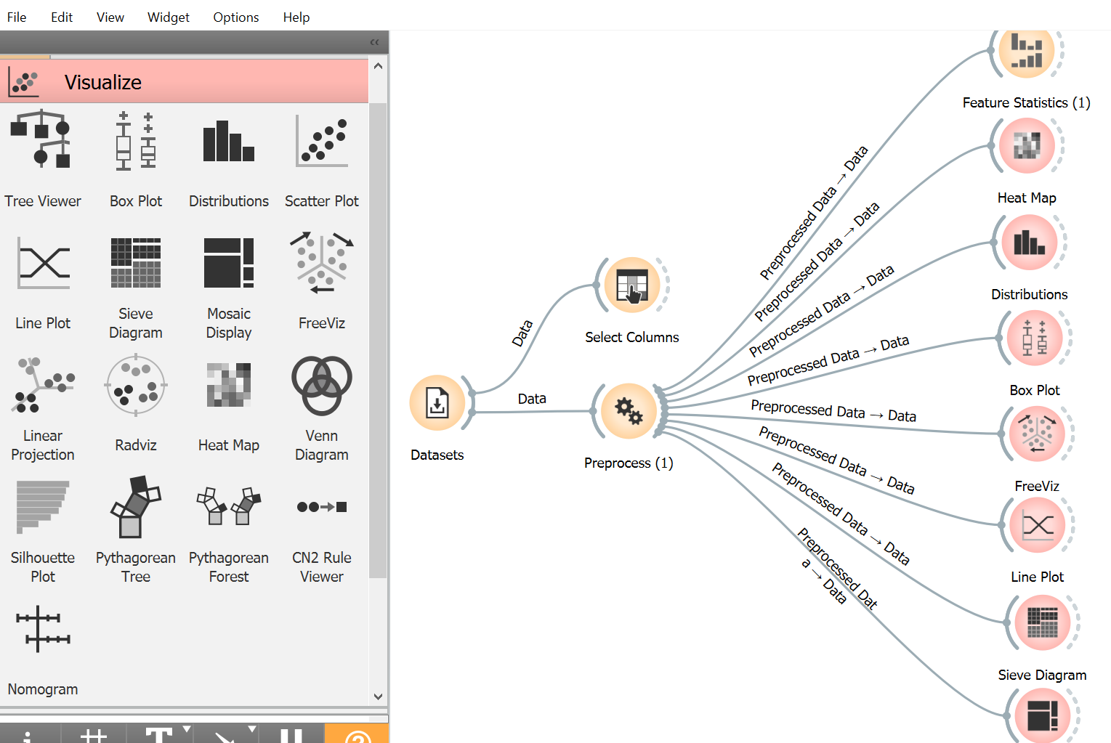
Task #1
Select an interesting data file. Read carefully its description!!
Try to conclude what are the best (?) features directly from visualization widgets?
Compare your conclusions with the results from widget „feature rank”
Which features are the closest ones???
Do the same with the principal components?
What can you conclude from the heat map and distance table visualization?

Slide 16
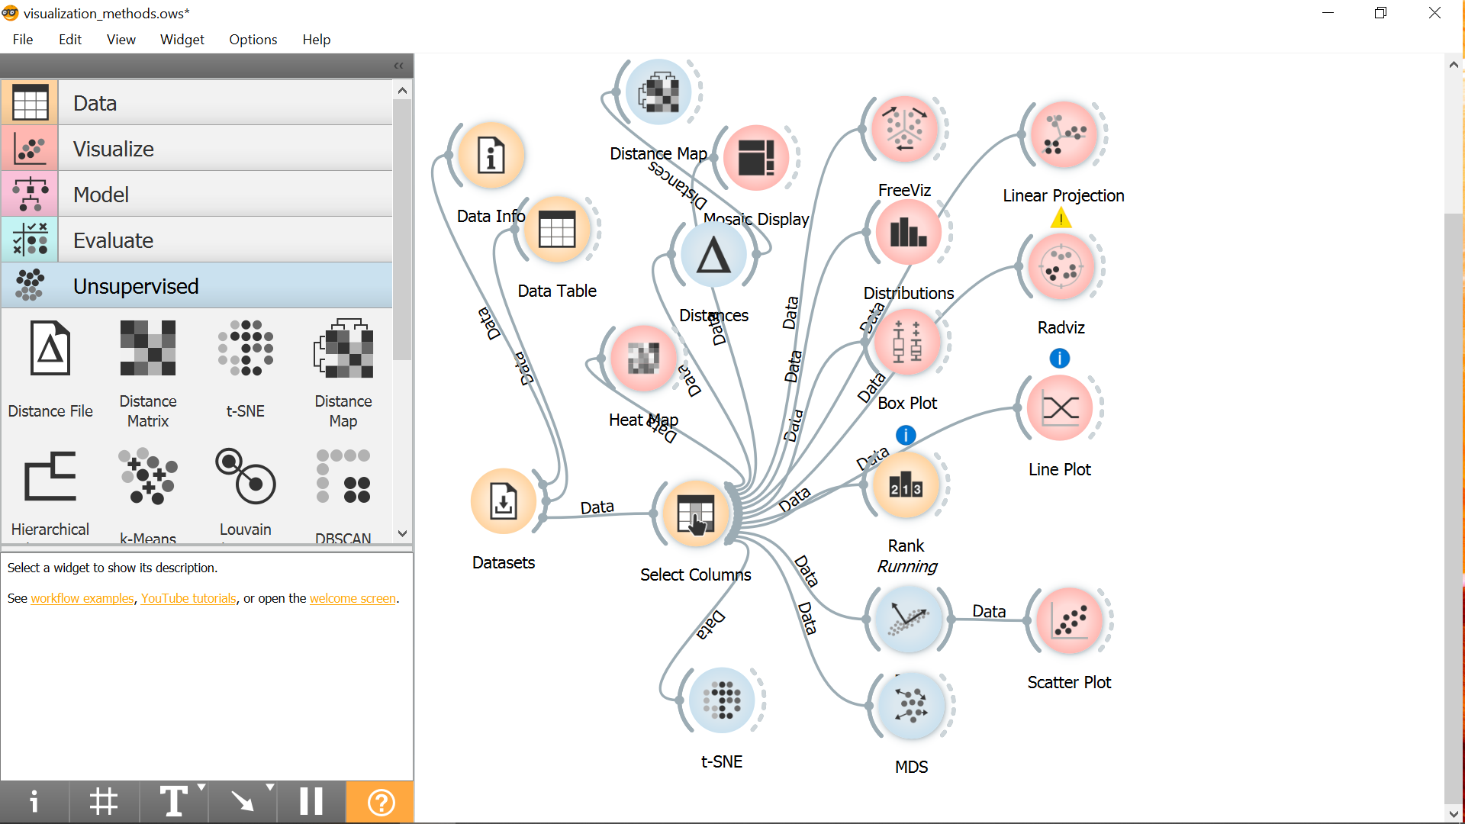
Task #2
Using FreeVis, RadVis and Line Plot widgets, try to support your conclusions from previous task question 6.

Slide 17
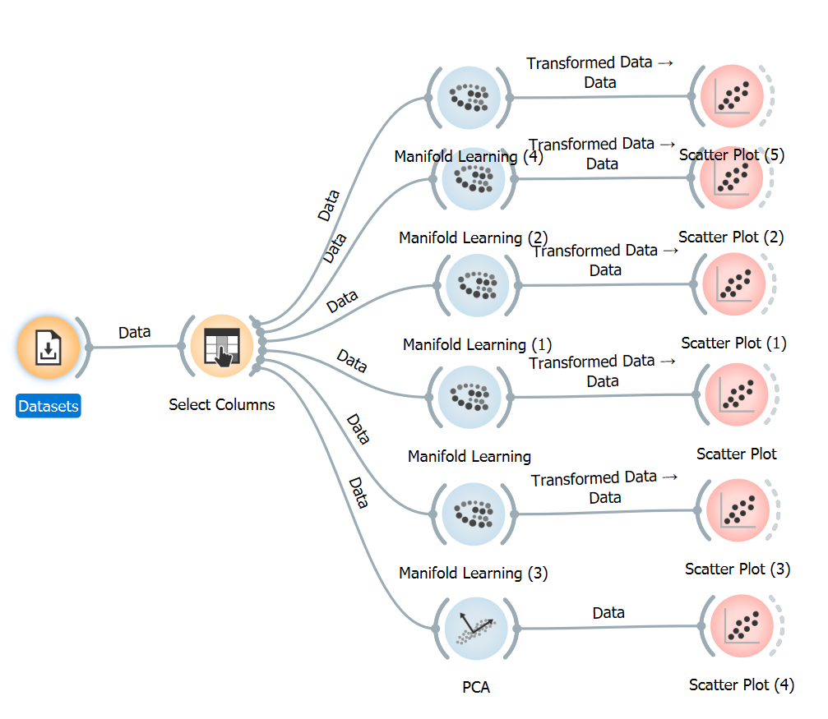
Task #3
Find the best embedding algorithm and compare visualizations for full and for the best subsets (the best three) of (a) features and (b) principal components (PC).
What (a or b) produces better visualization?
Observe the outliers for full and selected subsets of features (and PC).
Try to prepare such a data visualization that the outliers can be clearly visually selected.
Visualize the features and verify your conclusion from the previous task about their similarity.

Slide 18
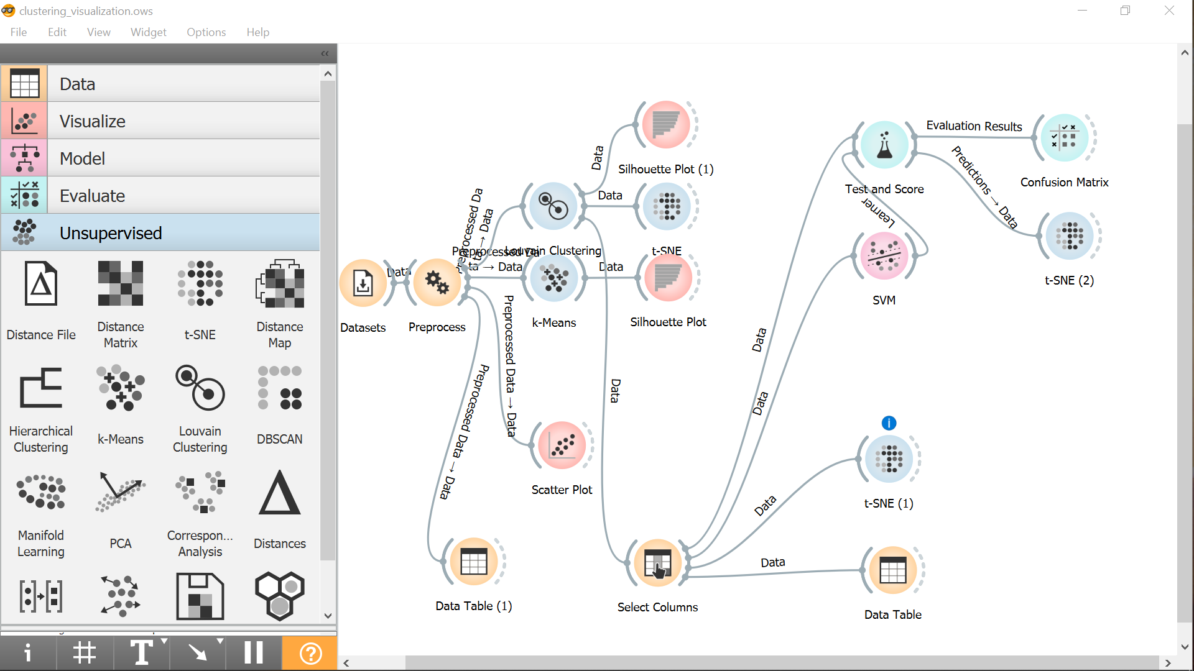
Task #4
Assume that the file you selected is not labeled!
Use the best clustering scheme for finding classes
Use the best classifier to reconstruct clusters
Visualize clusters/classes difference.
Use confusion matrix in formulating conclusions
Task #1

